Slide 1

Solution to Mental Health Challenges in Kenya
Daniel Kiago
Collins Kimani
Kenneth Kariuki
Duncan Maigua
Dylan Wanganga
Bonaventure Wafula

Slide 2
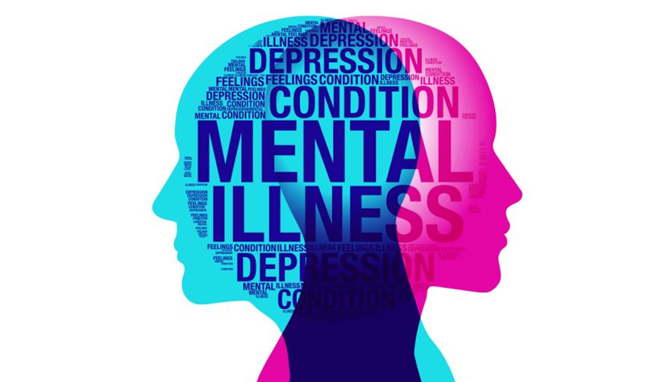
Problem-Statement
The problem is a lack of mental health knowledge and awareness among Kenyan youth leading to increased mental health issues, reduced performance, and potential harmful coping mechanisms like drug abuse.
The related GCGO is healthcare.
This problem matters because the mental well-being of the youth is crucial for their overall development and success in education and work.

Slide 3

Affected Group
One specific group of people impacted by this problem is Kenyan students in educational institutions.
The lack of mental health knowledge and awareness negatively affects their academic performance, study habits, and overall well-being.
This results in increased stress, anxiety, and potential long-term consequences on their educational journey and future prospects.

Slide 4

Factual Information 1
According to WHO, Kenya has 1.9 million people struggling with mental health challenges.
According to the Kenya Mental Health Policy the problem is worsening.
20-25% of people seeking outpatient health services in the nation present mental illness symptoms.
WHO report (2017)

Slide 5
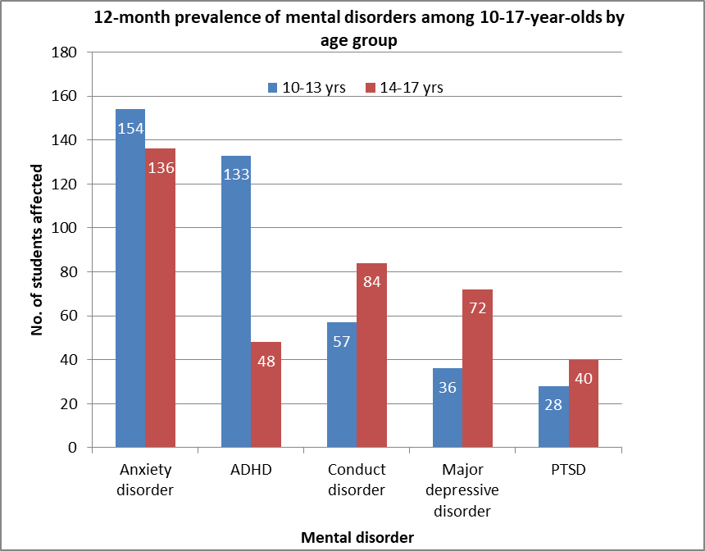
Factual Information 2
https://aphrc.org/wp-content/uploads/2022/10/K-NAMHS-report_2022.pdf

Slide 6
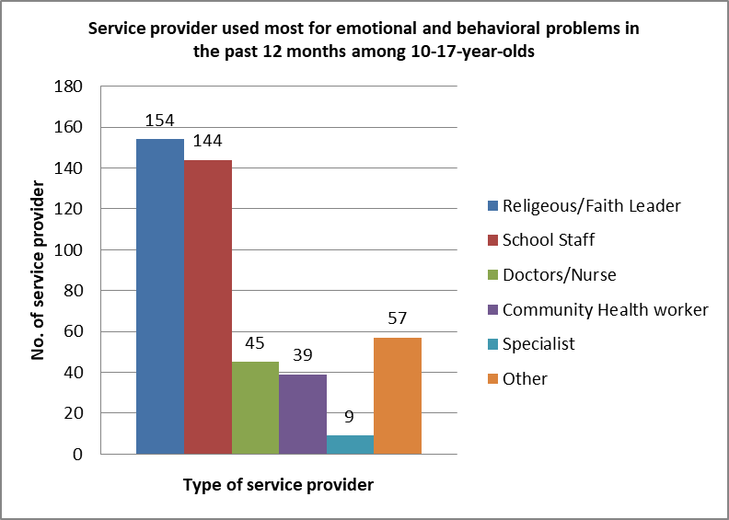
Factual Information 3
https://aphrc.org/wp-content/uploads/2022/10/K-NAMHS-report_2022.pdf

Slide 7

The solution is an online platform that can raise awareness and educate people on mental health issues.
The platform is juayourmentahealth.co.ke
Users on the platform will have access to
  Blogs
  Testimonials
  Toll-free Number to call when feeling depressed.
  24/7 access to a mental health specialist
We chose this solution because it allows for timely interventions, crisis prevention, and improved well-being.
This solution would be effective because it offers free, comprehensive and easily accessible mental health support at a click of a button

Slide 8
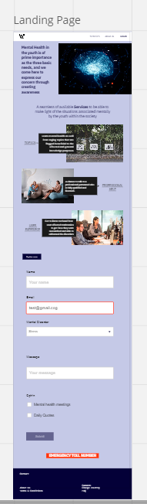
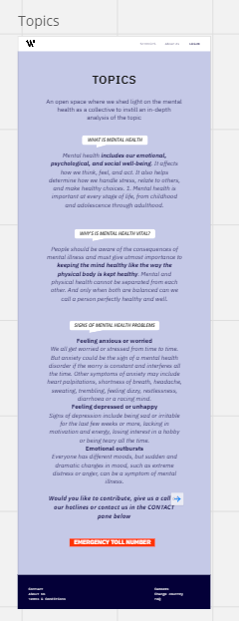
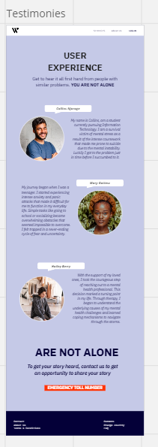
Wireframes

Slide 9
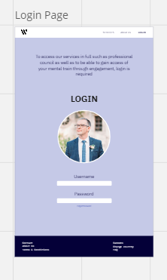
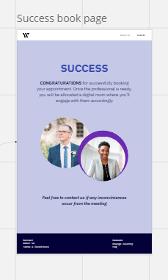
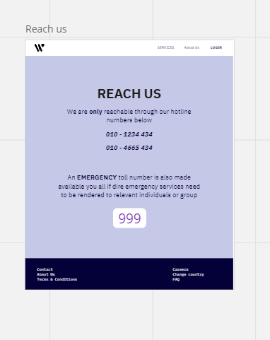
Wireframes

Slide 10

User Needs and Pain points
My user needs a user-friendly platform that provides accessible and affordable mental health services, including virtual consultations with licensed professionals.
My user needs a platform where they can listen to other victims of mental health illnesses so as to learn from their experiences as well.
My user needs education and resources on coping mechanisms and self-care practices for their mental well-being.

Slide 11

Recommendations
The response from the website after successfully booking a professional counsellor needs to show some hope for a quick response for assistance.

Slide 12

Next Steps
Should we receive the $20,000 funding we will:
  1. We will invest the funds in acquiring a domain and cloud server, hiring a data collection team, onboarding mental health specialists ,and securing an office space for toll-free calls.
  2. Consequently, we aim to have 2,000 registered users and 500 registered specialists by the 3rd quarter of 2023.

Slide 13

Restating WHY
Addressing mental health issues and promoting awareness can improve the quality of life, and contribute to a healthier and more resilient society.
Developing an online system as a solution would be impactful by providing free and accessible mental health support and services via digital devices owned by the majority of youth.

